Slide 1
Naive Bayes classifier
Naive Bayes is a machine learning classification algorithm that predicts the category of a data point using probability.
It assumes that all features are independent of each other.
Naive Bayes performs well in many real-world applications such as spam filtering, document categorisation and sentiment analysis.

Slide 2
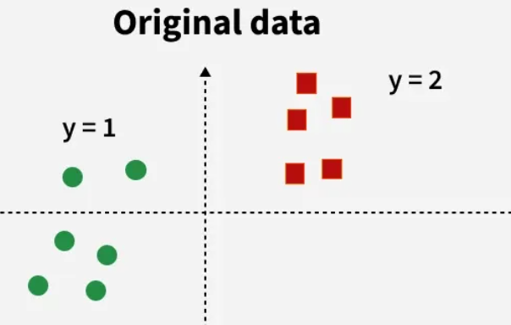
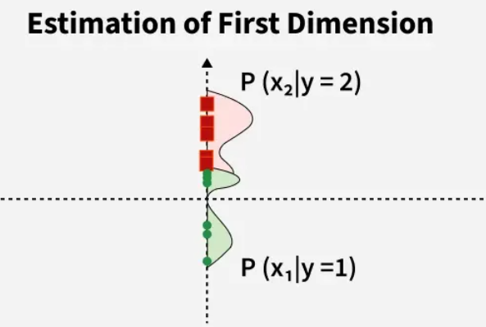
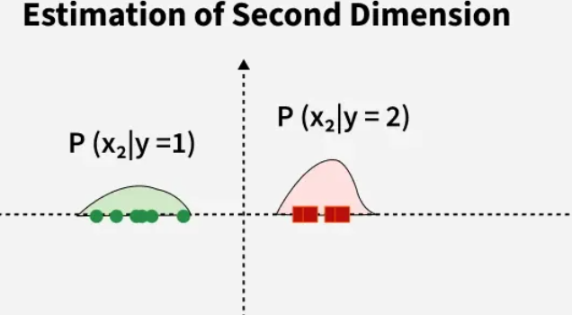
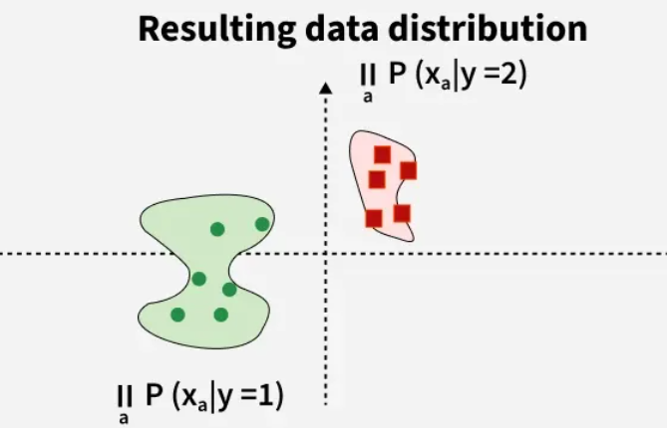
Naive Bayes classifier

Slide 3
Key Features of Naive Bayes Classifiers
Use Bayes' Theorem to classify data based on the probabilities of different classes given the features of the data. It is used mostly in high-dimensional text classification
The Naive Bayes Classifier is a simple probabilistic classifier and it has very few number of parameters which are used to build the ML models that can predict at a faster speed than other classification algorithms.
It is a probabilistic classifier because it assumes that one feature in the model is independent of existence of another feature. In other words, each feature contributes to the predictions with no relation between each other.
Naive Bayes Algorithm is used in spam filtration, Sentimental analysis, classifying articles and many more.

Slide 4
Assumption of Naive Bayes
The fundamental Naive Bayes assumption is that each feature makes:
Feature independence: This means that when we are trying to classify something, we assume that each feature (or piece of information) in the data does not affect any other feature.
Continuous features are normally distributed: If a feature is continuous, then it is assumed to be normally distributed within each class.
Discrete features have multinomial distributions: If a feature is discrete, then it is assumed to have a multinomial distribution within each class.
Features are equally important: All features are assumed to contribute equally to the prediction of the class label.
No missing data: The data should not contain any missing values.

Slide 5
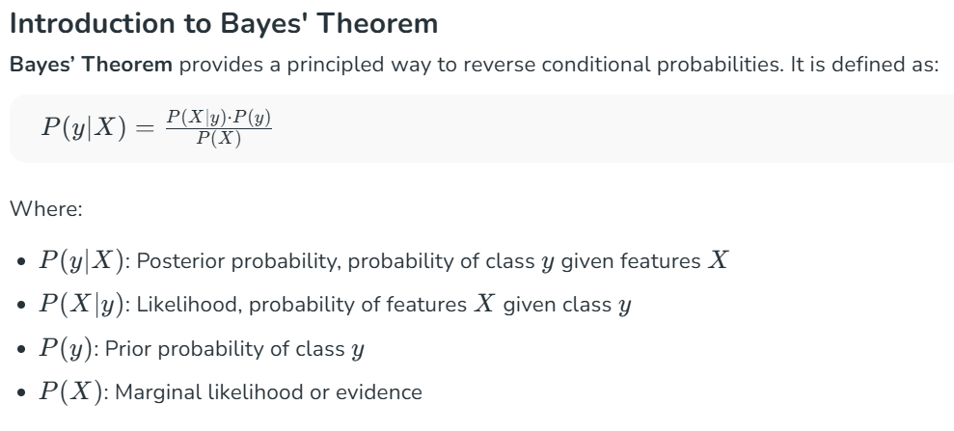

Slide 6
Consider a fictional dataset that describes the weather conditions for playing a game of golf. Given the weather conditions, each tuple classifies the conditions as fit(“Yes”) or unfit(“No”) for playing golf.
The dataset is divided into two parts i.e feature matrix and the response vector.
Feature matrix contains all the vectors(rows) of dataset in which each vector consists of the value of dependent features. In above dataset, features are ‘Outlook’, ‘Temperature’, ‘Humidity’ and ‘Windy’.
Response vector contains the value of class variable (prediction or output) for each row of feature matrix. In above dataset, the class variable name is ‘Play golf’.

Slide 7
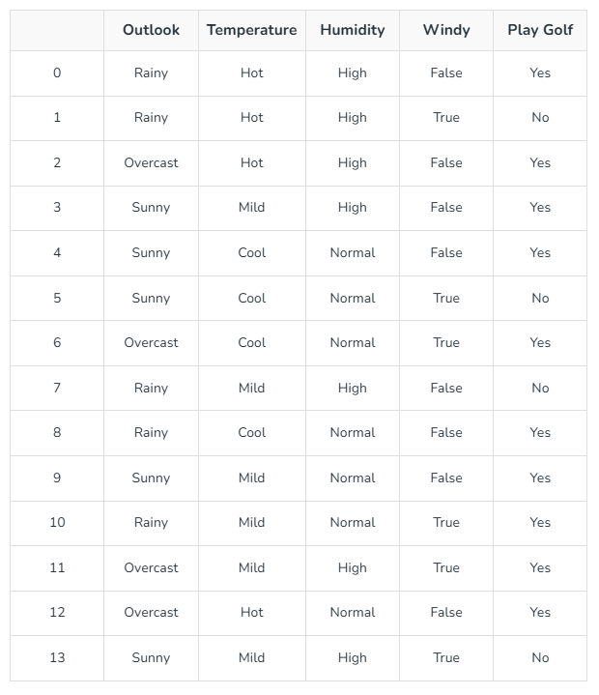
No

Slide 8
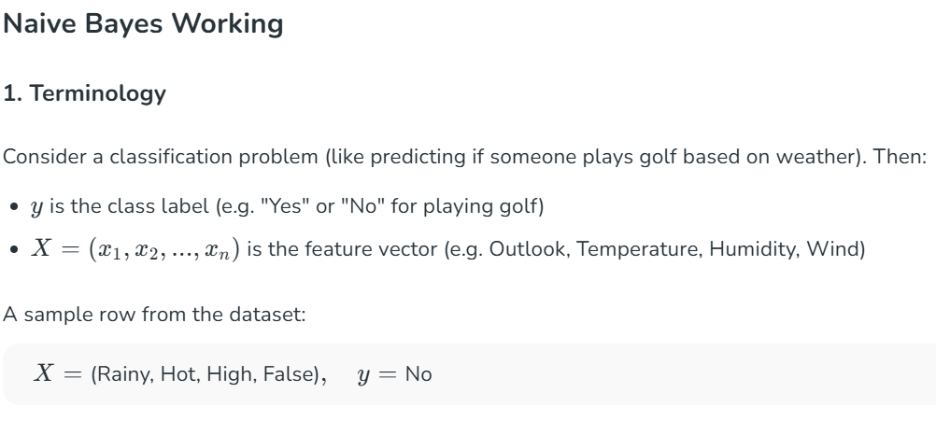

Slide 9
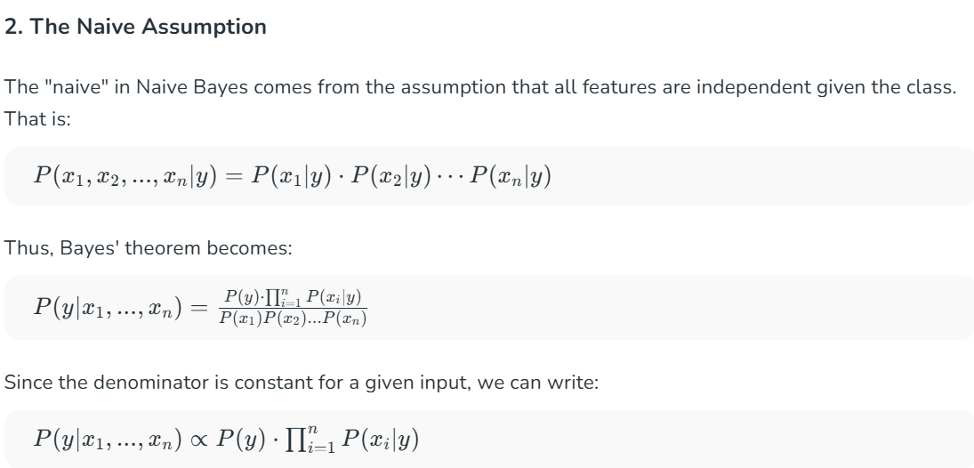

Slide 10
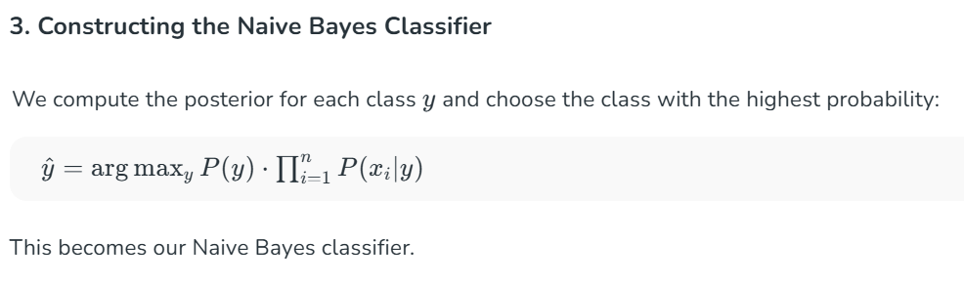

Slide 11
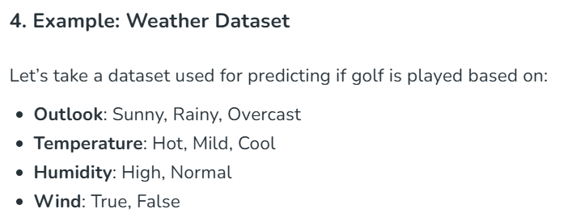

Slide 12
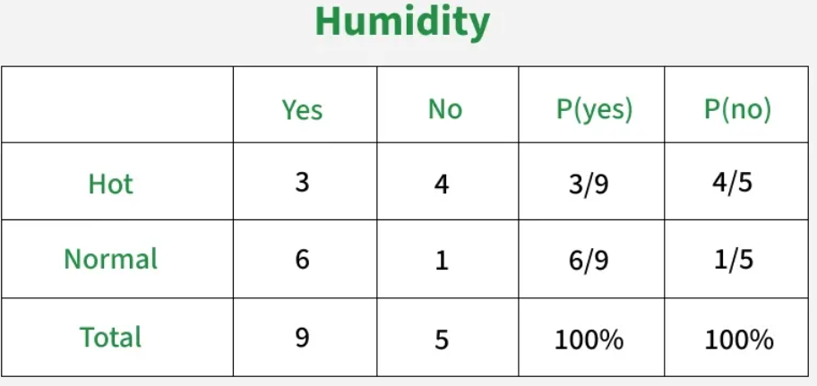
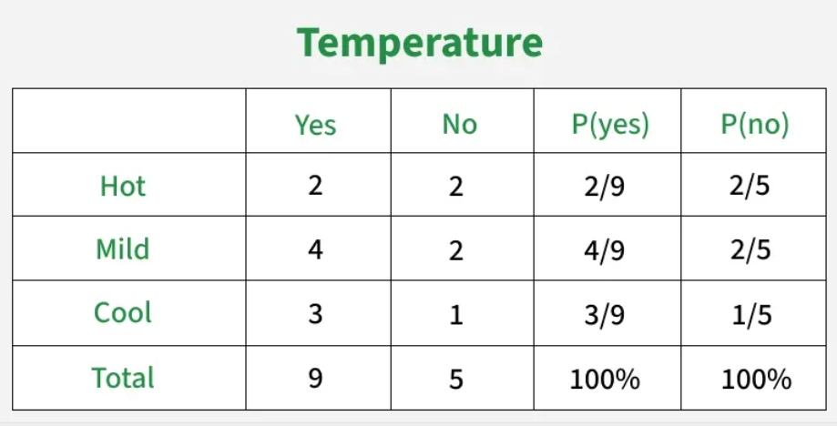
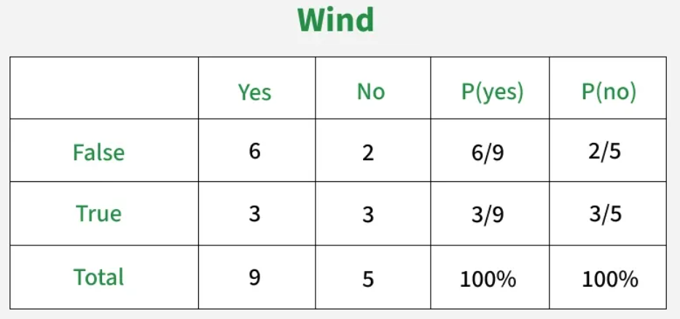
Outlook
 | Yes | No | P(yes) | P(no)
Sunny | 2 | 2 | 2/9 | 2/5
Overcast | 4 | 1 | 4/9 | 1/5
Rainy | 3 | 2 | 3/9 | 2/5
Total | 9 | 5 | 100% | 100%
High

Slide 13
Play |  | P(Yes)/P(Play)
Yes | 9 | 9/14
No | 5 | 5/14
Total | 14 | 100%

Slide 14
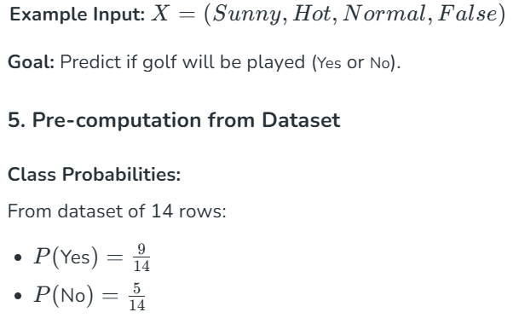
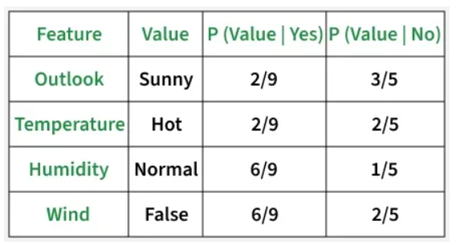

Slide 15
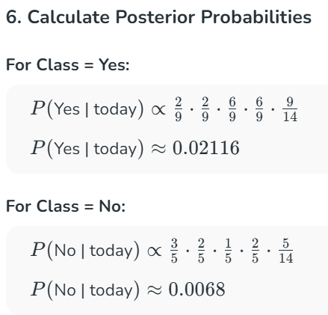
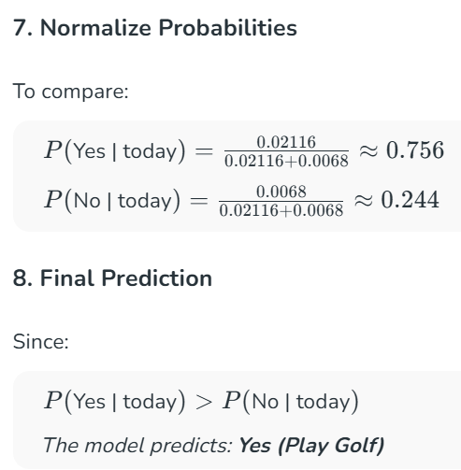

Slide 16
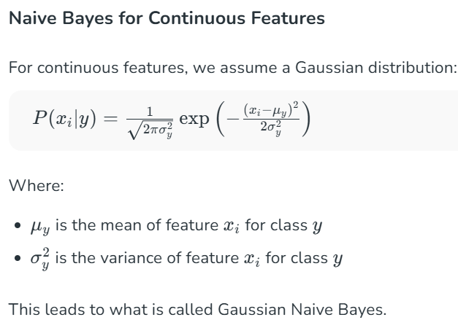

Slide 17
Three Types of Naive Bayes Model
1. Gaussian Naive Bayes
Continuous values associated with each feature are assumed to be distributed according to a Gaussian distribution.
2. Multinomial Naive Bayes
Multinomial Naive Bayes is used when features represent the frequency of terms (such as word counts) in a document. It is commonly applied in text classification, where term frequencies are important.
3. Bernoulli Naive Bayes
Bernoulli Naive Bayes deals with binary features, where each feature indicates whether a word appears or not in a document.
It is suited for scenarios where the presence or absence of terms is more relevant than their frequency. Both models are widely used in document classification tasks

Slide 18
Naive Bayes Model
Advantages
Easy to implement and computationally efficient.
Effective in cases with a large number of features.
Performs well even with limited training data.
It performs well in the presence of categorical features.
For numerical features data is assumed to come from normal distributions
Disadvantages
Assumes that features are independent, which may not always hold in real-world data.
Can be influenced by irrelevant attributes.
May assign zero probability to unseen events, leading to poor generalization.

Slide 19
Naive Bayes Model
Applications
Spam Email Filtering: Classifies emails as spam or non-spam based on features.
Text Classification: Used in sentiment analysis, document categorization and topic classification.
Medical Diagnosis: Helps in predicting the likelihood of a disease based on symptoms.
Credit Scoring: Evaluates creditworthiness of individuals for loan approval.
Weather Prediction: Classifies weather conditions based on various factors.

